Slide 1
EBN 111/122 ELECTRICITY AND ELECTRONICS
Chapter 2
Basic Laws
Copyright © The McGraw-Hill Companies, Inc. Permission required for reproduction or display.

Slide 2
Basic Laws - Chapter 2
2.2 Ohm’s Law.
2.3 Nodes, Branches, and Loops.
2.4 Kirchhoff’s Laws.
2.5 Series Resistors and Voltage Division.
2.6 Parallel Resistors and Current Division.
2.7 Wye-Delta Transformations.
L#1
L#2
L#3
L#4

Slide 3
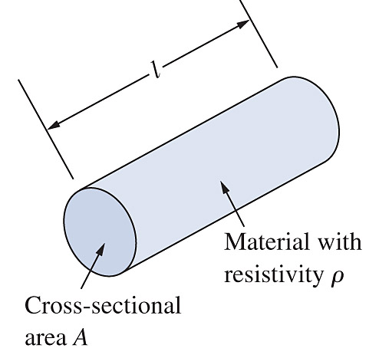
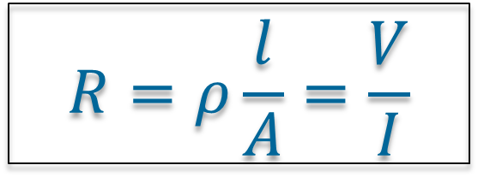
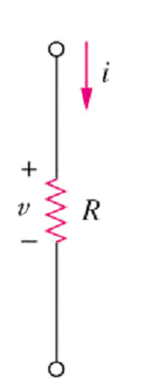
Chapter 2: Lecture #1 2.2 Ohms Law: V = IR
Ohm’s law states that the voltage V across a resistor is directly proportional to the current I flowing through the resistor.
Resistance R: Physical property of a material to resist the flow of current.
$$R=ρ\frac{l}{A}=\frac{V}{I}$$

Slide 4
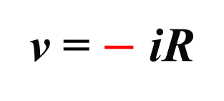
2.2 Ohms Law: V = IR
Passive Sign Convention
v = + iR
v = $−$ iR

Slide 5
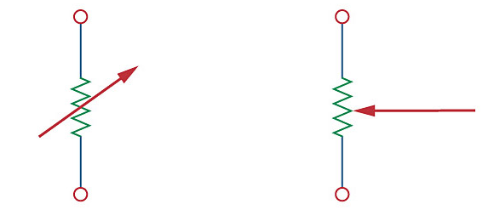

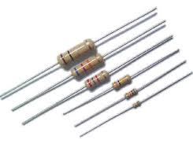
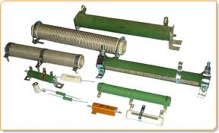
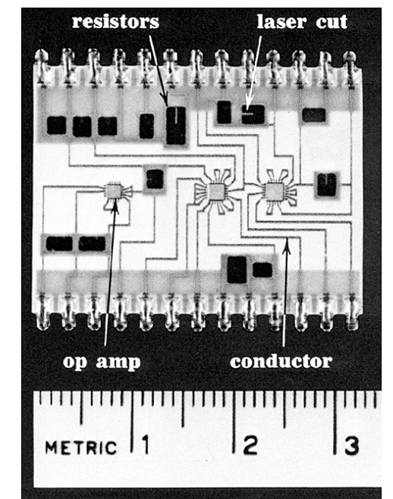

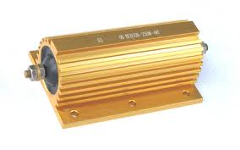
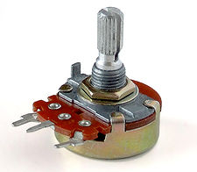
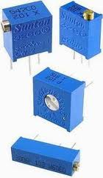

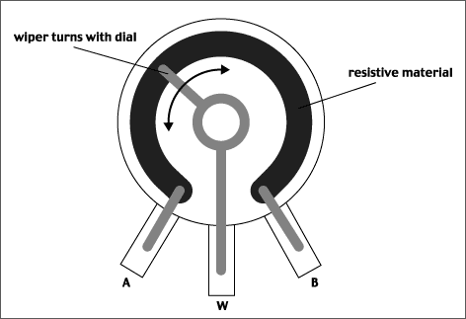

Slide 6

2.2 Ohms Law Resistivity ρ & Resistance R
Material | Resistivity (Ω⋅m) | Usage
Copper | 1.72 x 10⁻⁸ | Conductor
Gold | 2.45 x 10⁻⁸ | Conductor
Carbon | 4 x 10⁻⁵ | Semi-conductor
Silicon | 6.4 x 10² | Semi-conductor
Paper | 1 x 10¹⁰ | Insulator
Teflon | 3 x 10¹² | Insulator
$$R=ρ\frac{l}{A}= \left[Ω⋅m\frac{m}{m^{2}}\right]=\left[Ω\right]$$

Slide 7
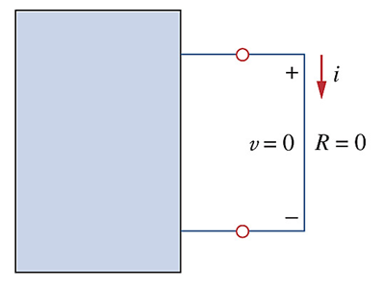
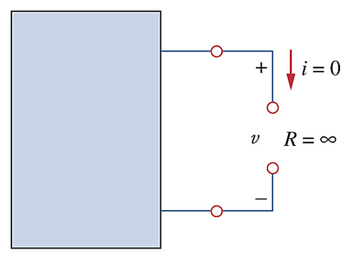
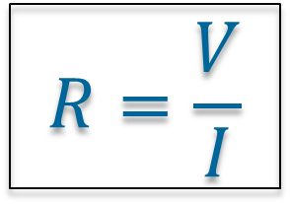
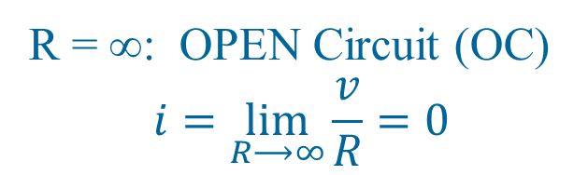
2.2 Ohms Law Resistance R - extremes
R = 0: SHORT Circuit (SC)
v = iR = i × 0 = 0
R = ∞: OPEN Circuit (OC)
$$i=\lim_{R⟶∞}{\frac{v}{R}}=0$$
$$R=\frac{V}{I}$$

Slide 8
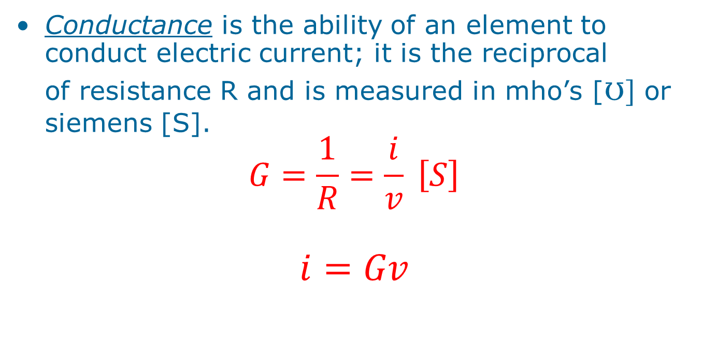
2.2 Ohms Law Conductance G
Conductance is the ability of an element to conduct electric current; it is the reciprocal of resistance R and is measured in mho’s [ʊ] or siemens [S].
$$G=\frac{1}{R}=\frac{i}{v} \left[S\right]$$
$$i=Gv$$

Slide 9
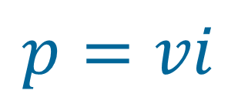
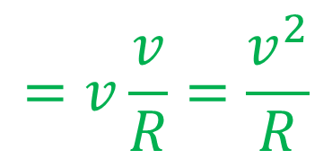
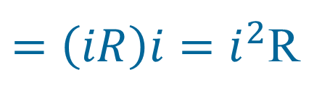
2.2 Ohms Law Power dissipated in a Resistor
$=\left(iR\right)i=i^{2}$R
v=iR
$$p=vi$$
$$=v\frac{v}{R}=\frac{v^{2}}{R}$$
i=v/R
MUCHO IMPORTANTE:
Since i², v² & R is always ≥0:
P in a resistor is ALWAYS ≥ 0 (positive)

Slide 10
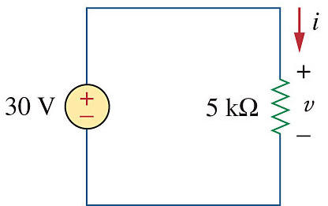
Example 2-2 In the circuit shown, calculate the current i, the conductance G and the power p.
i= v/R = 30 / 5×10³ = 6mA
G = 1/R = 1/5000 = 0.2 mS
p = i²R = (6×10⁻³ )² × 5×10³
= 180 mW
or:
p = +vi =30 × 0.006 = 0.18 W
or:
p = v²/R = (30)² / 5000 = 180mW

Slide 11
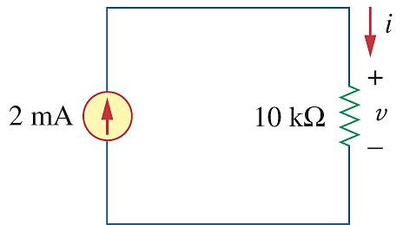
PP 2-2 For the circuit shown, calculate the voltage v, conductance G and power p.
v= iR = 2×10⁻³ × 10×10³
= 20 V
G = 1/R = 1/10000 = 100 μS
p = i²R = (2×10⁻³ )² × 10×10³
= 40 mW
or:
p = +vi =20 × 0.002 = 0.04 W

Slide 12
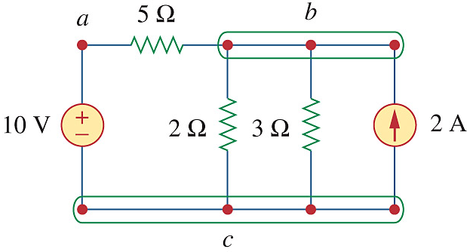
2.3 Nodes, Branches and Loops
A branch represents a single element such as a voltage source or a resistor.
A node is the point of connection between two or more branches.
A loop is any closed path in a circuit.

Slide 13
2.3 Nodes, Branches and Loops
BRANCHES
“A single element such as a voltage source or a resistor.”
5
How many branches?

Slide 14
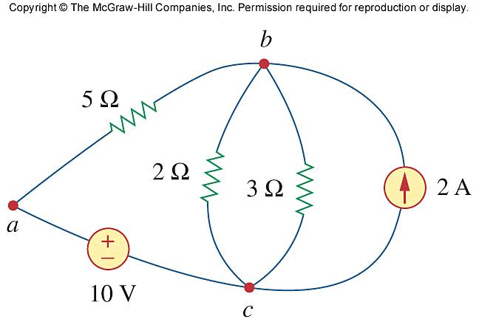
2.3 Nodes, Branches and Loops
NODES
“The point of connection between two or more branches.”
How many nodes?
3
Node a: 2 Branches
Node b: 4 Branches
Node c: 4 Branches

Slide 15
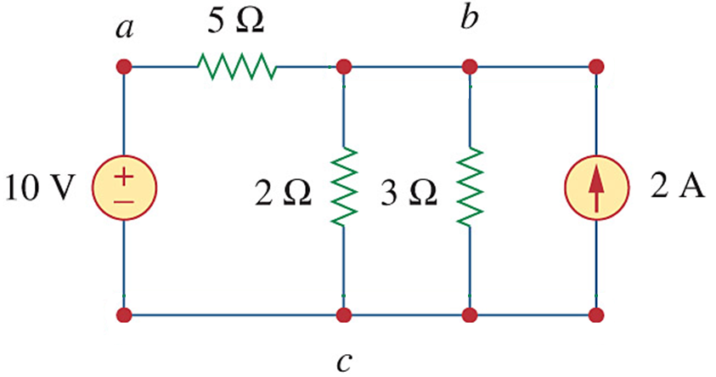
2.3 Nodes, Branches and Loops
LOOPS
“Any closed path in a circuit.”
6
How many loops?

Slide 16
2.3 Nodes, Branches and Loops
INDEPENDENT LOOPS
“A loop that contains at least one branch which is not a part of any other independent loop.”
“A loop that cannot be formed by combining / merging any of the other loops.”
Independent sets leads to independent equations

Slide 17
2.3 Nodes, Branches and Loops
When is it NOT an independent set?
If any loop can be formed by merging any of the other loops.
Dependent set 1:

Slide 18
2.3 Nodes, Branches and Loops
When is it NOT independent?
If any loop can be formed by merging any of the other loops.
Dependent set 2:

Slide 19
2.3 Nodes, Branches and Loops
When is it NOT independent?
If any loop can be formed by merging any of the other loops.
Dependent set 3:

Slide 20
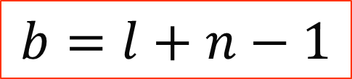
2.3 Nodes, Branches and Loops
Fundamental theorem of network topology
A network with b branches, n nodes, and l independent loops will satisfy the fundamental theorem of network topology:
$$b=l+n−1$$
# branches = # ind-loops + # nodes - 1
5 = 3 + 3 - 1

Slide 21
2.3 Nodes, Branches and Loops
Series and Parallel
SERIES
Two (2) elements are in series if:
They exclusively share a single node
∴ carry the same current.
PARALLEL
Two or more elements are in parallel if:
They are connected to the same two nodes
∴ have the same voltage

Slide 22
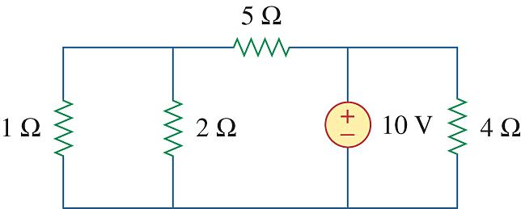
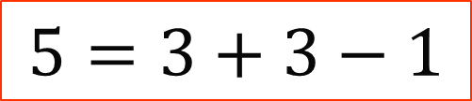
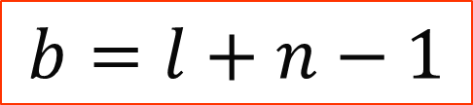
PP 2-4 How many branches, nodes and independent loops does the circuit have?
Branches =
Nodes =
Loops =
5
$$b=l+n−1$$
3
3
$$5=3+3−1$$

Slide 23
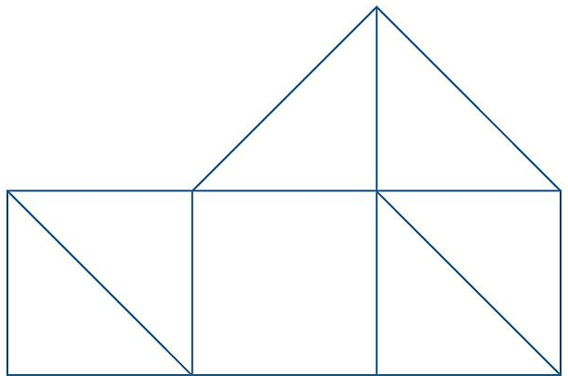
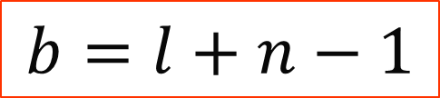
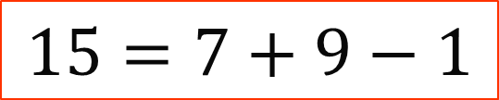
Problem 2.5 Find the number of nodes, branches and independent loops.
Branches =
Nodes =
Loops =
$$b=l+n−1$$
15
9
$$15=7+9−1$$
7

Slide 24
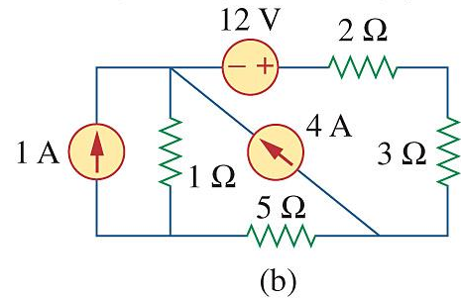
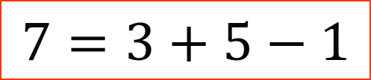
Problem 2.7b Find the number of nodes, branches and independent loops.
Branches =
Nodes =
Loops =
$$b=l+n−1$$
7
5
$$7=3+5−1$$
3

Slide 25
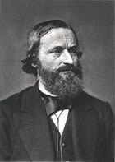
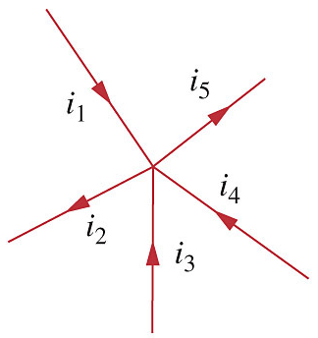
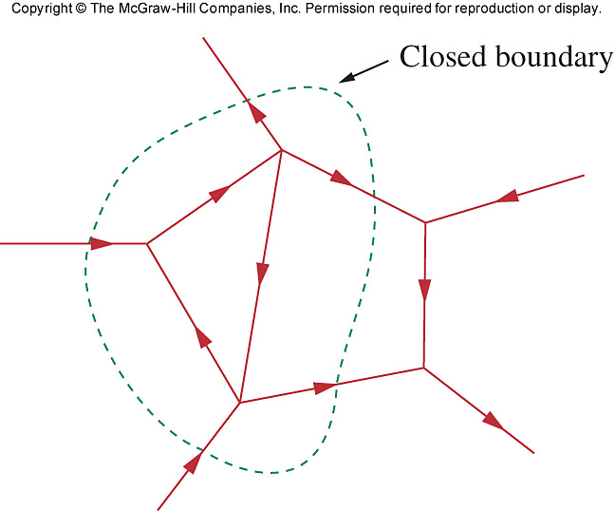
Chapter 2: Lecture #2 2.4 Kirchhoff’s Laws
Kirchhoff’s current law (KCL) states that the algebraic sum of currents entering and leaving a node (or a closed boundary) is zero.
N = Number of branches connected to the node.
i_{n} = n^{th} current entering or leaving.
Mathematically

Slide 26
2.4 Kirchhoff’s Laws (KCL) “What goes in, must come out”
Current entering a node: ADD +
Current leaving a node: SUBTRACT –
i₁ +(–i₂) + i₃ + i₄ + (– i₅) = 0
Entering = Leaving
i₁ + i₃ + i₄ = i₂ + i₅
i₁
i₂
i₅
Closed Boundary (Super Node):
– i₁ – i₂ – i₃ + i₄ + i₅ = 0
i₃
i₄

Slide 27
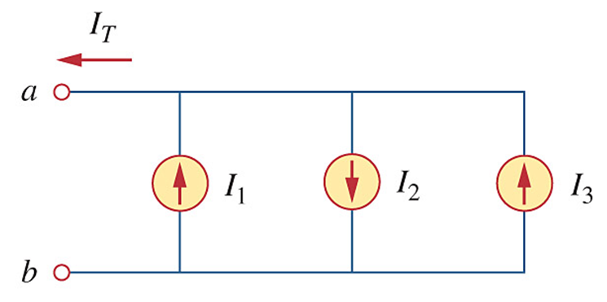
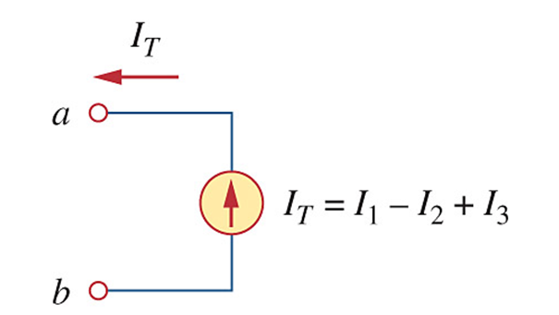



2.4 Kirchhoff’s Laws (KCL)
Current Sources in Parallel
I_{S} = + I₁ $−$ I₂ + I₃
I_{S} = $−$ I₁ + I₂ $−$ I₃

Slide 28
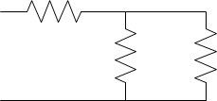
2.4 Kirchhoff’s Laws (KCL)
Resistive networks
– i₁ – i₂ + i₃ = 0
i₂
i₃
i₁

Slide 29
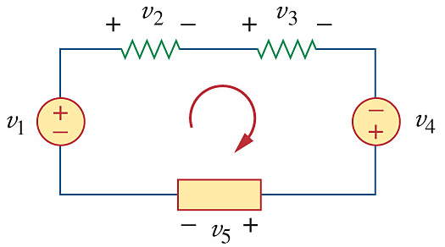
2.4 Kirchhoff’s Laws (KVL)
“What goes up, must come down”
Kirchhoff’s voltage law (KVL) states that the algebraic sum of all voltages around a closed path (or loop) is zero.
Convention:
Always go clock wise
In at +: ADD
In at –: SUBTRACT
– v₁ + v₂ + v₃ – v₄ + v₅ = 0
Mathematically,

Slide 30
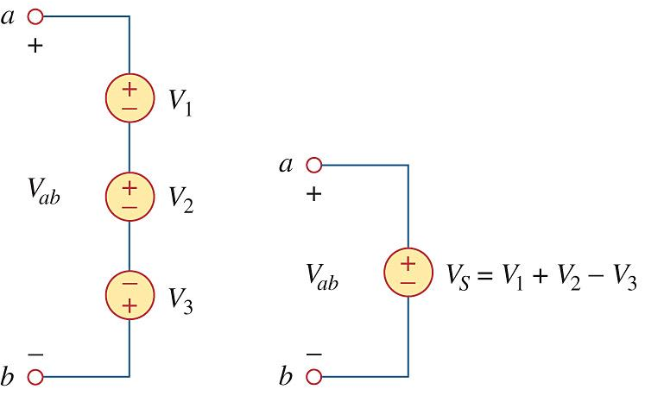
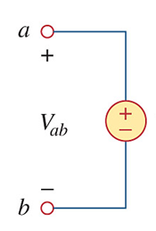


2.4 Kirchhoff’s Laws (KVL)
Voltage sources in series
V_{S} = $−$ V₁ $−$ V₂ $+$ V₃

Slide 31
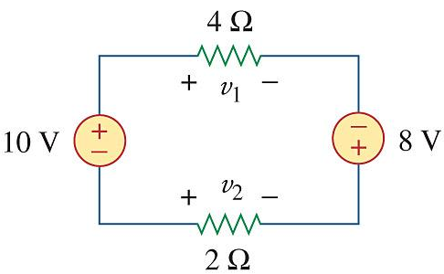
PP 2-5 Find i, v₁ and v₂.
KVL: – 10 + v₁ – 8 – v₂ = 0
i
Ohm: v₁ = 4i
Ohm: v₂ = – 2i
– 10 + (4i) – 8 – (-2i) = 0
6i = 18
i = 3 A
∴v₁ = 4i = 4⋅3 = 12 V
v₂ = – 2i = –2⋅3 = –6 V
The Test:…
– 10 + v₁ – 8 – v₂ = 0
– 10 + 12 – 8 – (–6) = – 18 + 18 = 0

Slide 32
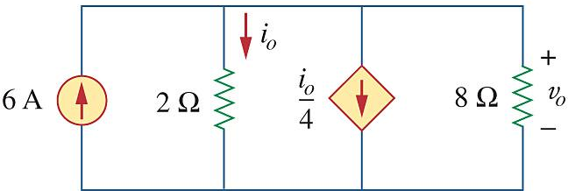
Observation: Voltage across ALL elements is v_{o}.
PP 2-7 Find current i_{o} and voltage v_{o}.
i₈ = v_{o}/8 A (ohm’s law)
KCL: + 6 – i_{o} – i_{o}/4 – v_{o}/8 = 0
Ohm: i_{o} = v_{o}/2 ∴v_{o} = 2i_{o}
+ 6 – i_{o} – i_{o}/4 – 2i_{o}/8 = 0
6 = 1.5i_{o}
i_{o} = 4 A
The Test:…
+ 6 – i_{o} – i_{o}/4 – v_{o}/8 = 0
+ 6 – 4 – 4/4 – 8/8 = 0
6 – 4 – 1 – 1 = 0
v_{o} = 2i_{o} = 2⋅4 = 8 V

Slide 33
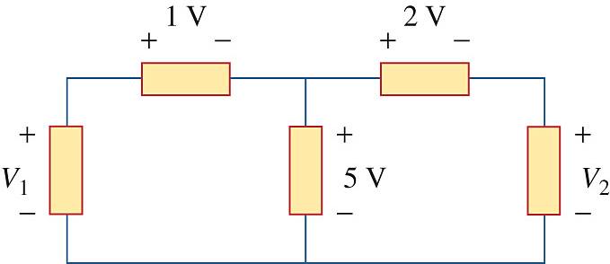
Problem 2-11 Calculate V₁ and V₂.
1
2
KVL1: – V₁ + 1 + 5 = 0
∴V₁ = 6 V
The Test:…
– V₁ + 1 + 2 + V₂ = 0
– 6 + 1 + 2 + 3 = 0
– 6 + 6 = 0
KVL2: + V₂ – 5 + 2 = 0
∴V₂ = 3 V

Slide 34
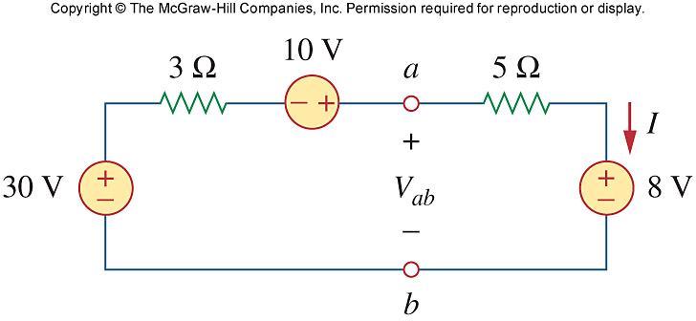
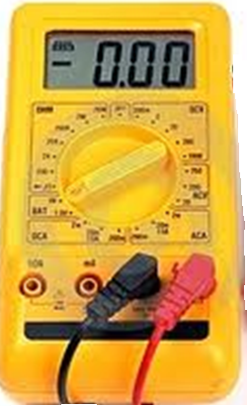
Problem 2-18 Determine I and V_{ab}.
v = + iR
1
V_{ab}
+ v₃=3I –
+ v₅=5I –
2
3
KVL1: – 30 + 3I – 10 + 5I + 8 = 0
∴8I = 32
I = 4 A
KVL2: – V_{ab} + 5I + 8 = 0
∴V_{ab} = 5(4) + 8 = 28 V
KVL3: – 30 + 3I – 10 + V_{ab} = 0
∴V_{ab} = 40 – 3(4) = 28 V

Slide 35
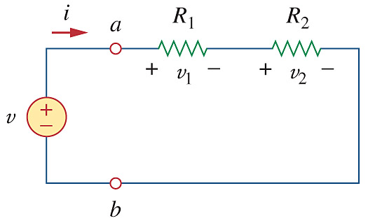
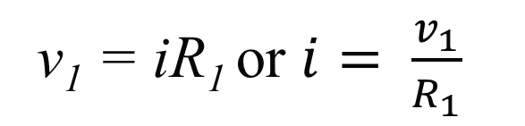


Chapter 2: Lecture #3 2.5 Series Resistors & Voltage Division
Series: Two or more elements are in series if they are cascaded or connected sequentially and consequently carry the same current.
v₁ = iR₁ or $i= \frac{v_{1}}{R_{1}}$
v₂ = iR₂ or $i= \frac{v_{2}}{R_{2}}$
KVL: – v + v₁ + v₂ = 0
v = v₁ + v₂
= i(R₁ + R₂)
= iR_{eq}
$$i= \frac{v}{R_{1}+R_{2}}$$

Slide 36



2.5 Series Resistors & Voltage Division
VOLTAGE DIVISION
v₁ = iR₁
v₂ = iR₂
$$i= \frac{v}{R_{1}+R_{2}}$$
Substitute i into v₁ and v₂:
$$v_{1}= \frac{v}{R_{1}+R_{2}}R_{1}=\frac{R_{1}}{R_{1}+R_{2}}v=\frac{R_{1}}{R_{eq}}v$$
$$v_{2}= \frac{v}{R_{1}+R_{2}}R_{2}=\frac{R_{2}}{R_{1}+R_{2}}v=\frac{R_{2}}{R_{eq}}v$$

Slide 37


2.5 Series Resistors & Voltage Division
R_{eq} for more than 2 R’s
R₁
R₂
R₃
R_{N}
+ v₁ –
+ v₂ –
+ v₃ –
+ v_{N} –
v
$$R_{eq}=R_{1}+R_{2}+R_{3}+…+R_{N}=\sum_{n=1}^{N}{R_{n}}$$

Slide 38




2.5 Series Resistors & Voltage Division
R_{eq} for more than 2 R’s
$$R_{eq}=R_{1}+R_{2}+R_{3}+R_{4}+R_{5}+R_{6}+R_{7}=\sum_{n=1}^{7}{R_{n}}$$
R₁
R₂
$$v_{4}= \frac{R_{4}}{R_{eq}}v$$
??
R₃
v
+
v₄
–
$$v_{6}= \frac{R_{6}}{R_{eq}}v$$
??
R₄
R₇
R₆
R₅

Slide 39


2.6 Parallel Resistors & Current Division
Parallel: Two or more elements are in parallel if they are connected to the same two nodes and consequently have the same voltage across them.
Ohm:
i₁ = v/R₁
i₂ = v/R₂
v = i₁R₁ = i₂R₂
KCL: i – i₁ – i₂ = 0
i = i₁ + i₂
Substitute i₁ and i₂ into KCL:
$$i= \frac{v}{R_{1}}+\frac{v}{R_{2}}=v\left(\frac{1}{R_{1}}+\frac{1}{R_{2}}\right)=v\frac{1}{R_{eq}}$$

Slide 40




2.6 Parallel Resistors & Current Division
R_{eq} for 2 R’s
$$i=v\left(\frac{1}{R_{1}}+\frac{1}{R_{2}}\right)=v\frac{1}{R_{eq}}$$
$$\frac{1}{R_{eq}}=\frac{1}{R_{1}}+\frac{1}{R_{2}}$$
$$=\frac{R_{1}+R_{2}}{R_{1}R_{2}}$$
For TWO // resistors:
$$R_{eq}=\frac{R_{1}R_{2}}{R_{1}+R_{2}}=R_{||}$$

Slide 41





2.6 Parallel Resistors & Current Division
R_{eq} for more than 2 R’s
$$R_{eq}=\frac{R_{1}R_{2}}{R_{1}+R_{2}}$$
R₁
R₂
R₃
R_{N}
If
Then does it mean that:
NO!
$$R_{eq}=\frac{R_{1}R_{2}R_{3}{⋅…⋅R}_{N}}{R_{1}+R_{2}+R_{3}+{…+R}_{N}}$$
$$\frac{1}{R_{eq}}=\frac{1}{R_{1}}+\frac{1}{R_{2}}+\frac{1}{R_{3}}+…+\frac{1}{R_{N}}$$

Slide 42




2.6 Parallel Resistors & Current Division
Current Division
$$v=iR_{eq}=i\frac{R_{1}R_{2}}{R_{1}+R_{2}}$$
Ohm:
v = i₁R₁ = i₂R₂
Substituting v:
$$i_{1}R_{1}=i\frac{R_{1}R_{2}}{R_{1}+R_{2}}$$
$$i_{1}=i\frac{R_{2}}{R_{1}+R_{2}}$$
$$i_{2}=i\frac{R_{1}}{R_{1}+R_{2}}$$
Ito i₂:

Slide 43



2.6 Parallel Resistors & Current Division
Current Division – more than 2 R’s
$$G_{n}=\frac{1}{R_{n}}$$
G₁
G₂
G₃
G_{N}
$$\frac{1}{R_{eq}}=\frac{1}{R_{1}}+\frac{1}{R_{2}}+\frac{1}{R_{3}}+…+\frac{1}{R_{N}}$$
$$∴G_{eq}=G_{1}+G_{2}+G_{3}+…+G_{N}=\sum_{n=1}^{N}{G_{n}}$$

Slide 44




2.6 Parallel Resistors & Current Division
Voltage Division - Summary
+
+
+
+
R₁
V₁
$$V_{1}=\frac{R_{1}}{R_{1}+R_{2}}V$$
$$V_{1}=\frac{R_{1}}{R_{1}+R_{2}+R_{3}}V$$
R₁
V₁
_
_
V
+
+
V
R₂
V₂
R₂
V₂
_
_
+
_
R₃
V₃
_
_

Slide 45







2.6 Parallel Resistors & Current Division
Current Division - Summary
i₁
i₂
i
$$i_{1}=i\frac{R_{2}}{R_{1}+R_{2}}$$
R₁
R₂
$$i_{1}=?$$
i₁
i₂
i₂
$$i_{1}=i\frac{R_{2}R_{3}}{R_{1}+R_{2}+R_{3}}$$
i
R₁
R₂
R₃
$$i_{1}=i\frac{G_{1}}{G_{1}+G_{2}+G_{3}}$$

Slide 46

PP 2-9 Determine R_{eq}

Slide 47

PP 2-12 Find v₁ an v₂ in the circuit. Also calculate i₁ and i₂ and the power dissipated in the 12 Ω and 40 Ω resistors.

Slide 48

Problem 2-31 Determine i₁ to i₅ .

Slide 49

Chapter 2: Lecture #4 2.7 Wye-Delta Transformations WYE / Y or T or Star Network

Slide 50

2.7 Wye-Delta Transformations Δ or π Network
Δ
π

Slide 51

2.7 Wye-Delta Transformations Y inside a Δ
R_{c}
Delta Δ: R_{a}, R_{b}, R_{c}.
Name the nodes a, b, and c.
R_{a} is opposite node a
R_{b} is opposite node b
R_{c} is opposite node c
R_{b}
R_{a}

Slide 52
2.7 Wye-Delta Transformations Y inside a Δ
R₁
R₂
Delta Y: R₁, R₂, R₃.
Name the nodes a, b, and c.
R₁ is connected to node a
R₂ is connected to node b
R₃ is connected to node c
R₃

Slide 53


2.7 Wye-Delta Transformations Y inside a Δ
Delta ⟶ Wye
Wye ⟶ Delta
Δ
⟵
Y
Y
⟵
Δ
All possible pro-ducts of Y R’s 2@t
Product of adjacent Δ R’s
$$\sum{R_{n}}$$

Slide 54

2.7 Wye-Delta Transformations Special Case: Balanced Y and Δ
R_{a} = R_{b} = R_{c} = R_{Δ}
and
R₁ = R₂ = R₃ = R_{Y}
then:
$$R_{Y}=\frac{R_{∆}}{3} or R_{∆}=3R_{Y}$$

Slide 55


Problem 2-48 Convert the circuits from Y to Δ :

Slide 56


Problem 2-49 Convert the circuits from Δ to Y :

Slide 57

Problem 2-44 Determine R_{eq} between terminals a and b :

Slide 58

Chapter 2: Lecture #5 Additional Problems
Problem 2-17 Determine v_{1,} v₂ and v₃ in the circuit.

Slide 59

Problem 2-32 Determine i_{1,} i₂, i₃ and i₄ in the circuit.

Slide 60

Problem 2-37 Find R for the circuit.

Slide 61

Problem 2-55 Calculate I_{o} in the circuit.

